Slide 1

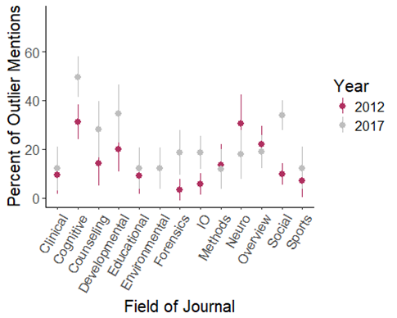
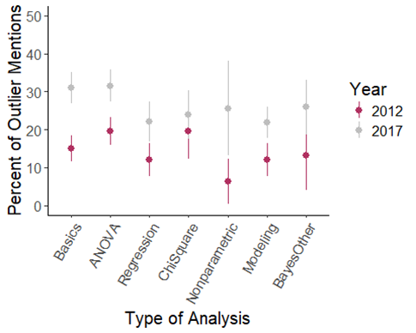
ABSTRACT
This study examined the impact of the growth of the Open Science Framework on report rates and transparent descriptions of outlier analyses in studies, as the importance of understanding the data manipulation in a study is crucial to creating reproducible science.
TABLES AND GRAPHS AND STUFF
DISCUSSION
Overall, reporting of outliers increased in most fields of psychology between 2012 and 2017. Reporting also increased on average for all types of analysis.
The most significant improvements were in the cognitive and social fields. This may have been motivated by the replication crisis experienced most strongly within these branches.
(Need results for reasons.)
METHOD
Fields
The topic list was created to capture large fields of psychology with small overlaps (i.e. cognition and neuropsychology) while avoiding specific subfields of topics (i.e. cognition, perception, and memory).
Journals
Two journals from each field were selected based on the following criteria: (1) high impact factors, (2) impact factors over one a minimum, (3) a mix of publishers if possible and, (4) availability due to university resources
Articles
Fifty articles from each journal were examined for data analysis, twenty-five from 2012 and twenty-five from 2017. Data collection of articles started at the last volume publication from 2012 and 2017 and progressed backwards until twenty-five articles had been found. We excluded online first publications and started in 2012 and 2017 to ensure time for errata and retraction of articles. Articles were included if they met the following criteria: (1) included data analyses, (2) included multiple participants or data-points, and (3) analyses were based on human subjects or stimuli.
Data Analysis
All 25 articles from the different topic areas were coded by:
Types of analysis
How many participants were in the original study
If they mentioned outliers
Type of outliers mentions:
Statistical reason or participant error
If outliers were mentioned, were they:
People or data points
Included or excluded in the analysis
Why were they included or excluded
How many participants were included in the final analysis
Year | Field | Participant Error | Statistical Reason | Unusable Data
2012 | Clinical | 20% | 80% | 0.00%
2017 |  | 33.33% | 83.33% | 0.00%
2012 | Cognitive | 50.98% | 64.71% | 3.92%
2017 |  | 67.16% | 46.27% | 0.00%
2012 | Counseling | 0.00% | 100% | 0.00%
2017 |  | 12.50% | 87.50% | 0.00%
2012 | Developmental | 71.43% | 35.71% | 0.00%
2017 |  | 61.90% | 42.86% | 0.00%
2012 | Educational | 0.00% | 100% | 0.00%
2017 |  | 0.00% | 100% | 0.00%
2012 | Environmental | 42.86% | 28.57% | 28.57%
2017 |  | 28.57% | 71.43% | 0.00%
2012 | Forensics | 0.00% | 100% | 0.00%
2017 |  | 53.85% | 30.77% | 23.08%
2012 | IO | 0.00% | 100% | 0.00%
2017 |  | 82.61% | 8.70% | 13.04%
2012 | Methods | 33.33% | 88.89% | 0.00%
2017 |  | 42.86% | 100% | 0.00%
2012 | Neuro | 38.89% | 88.89% | 0.00%
2017 |  | 0.00% | 100% | 0.00%
2012 | Social | 37.50% | 50.00% | 18.75%
2017 |  | 76.92% | 37.18% | 6.41%
2012 | Sports | 0.00% | 100% | 0.00%
2017 |  | 42.86% | 42.86% | 14.29%
2012 | Overview | 36.00% | 64.00% | 0.00%
2017 |  | 36.00% | 88.00% | 4.00%
Field | Data Points | Participants | Both | None
Clinical | 80.00% | 20.00% | 0.00 | 0.00%
Clinical | 33.33% | 50.00% | 0.00% | 16.67%
Cognitive | 45.10% | 50.98% | 3.92% | 0.00%
Cognitive | 28.36% | 53.73% | 17.91% | 0.00%
Counseling | 25.00% | 50.00% | 0.00% | 25.00%
Counseling | 6.25% | 81.25% | 0.00% | 12.50%
Developmental | 14.29% | 78.57% | 7.14% | 0.00%
Developmental | 23.81% | 71.43% | 0.00% | 4.76%
Educational | 20.00% | 20.00% | 0.00% | 60.00%
Educational | 57.14% | 28.57% | 0.00% | 14.29%
Environmental | 0.00% | 100.00% | 0.00% | 0.00%
Environmental | 14.29% | 85.71% | 0.00% | 0.00%
Forensics | 50.00% | 50.00% | 0.00% | 0.00%
Forensics | 7.69% | 92.31% | 0.00% | 0.00%
IO | 0.00% | 83.33% | 16.67% | 0.00%
IO | 8.70% | 91.30% | 0.00% | 0.00%
Methods | 11.11% | 88.89% | 0.00% | 0.00%
Methods | 42.86% | 57.14% | 0.00% | 0.00%
Neuro | 66.67% | 16.67% | 11.11% | 5.56%
Neuro | 70.00% | 20.00% | 0.00% | 10.00%
Overview | 40.00% | 52.00% | 8.00% | 0.00%
Overview | 32.00% | 56.00% | 12.00% | 0.00%
Social | 0.00% | 100.00% | 0.00% | 0.00%
Social | 5.13% | 89.74% | 5.13% | 0.00%
Sports | 0.00% | 100.00% | 0.00% | 0.00%
Sports | 14.29% | 71.43% | 0.00% | 14.29%
Field | Effect Size Change (d) | Number of Experiments 2012 | Number of Experiments 2017
Clinical | 0.26 | 54 | 50
Cognitive | 2.93 | 164 | 135
Counseling | 1.66 | 56 | 57
Developmental | 1.48 | 70 | 71
Educational | 0.48 | 56 | 58
Environmental | 0.00 | 58 | 58
Forensics | 2.56 | 62 | 70
Industrial Organizational | 2.79 | 104 | 124
Neurological/ Physiological | 1.60 | 59 | 56
Social | 6.64 | 164 | 231
Sports | 0.75 | 58 | 57
Overview | 0.11 | 114 | 132
CONTACT INFORMATION

Slide 2

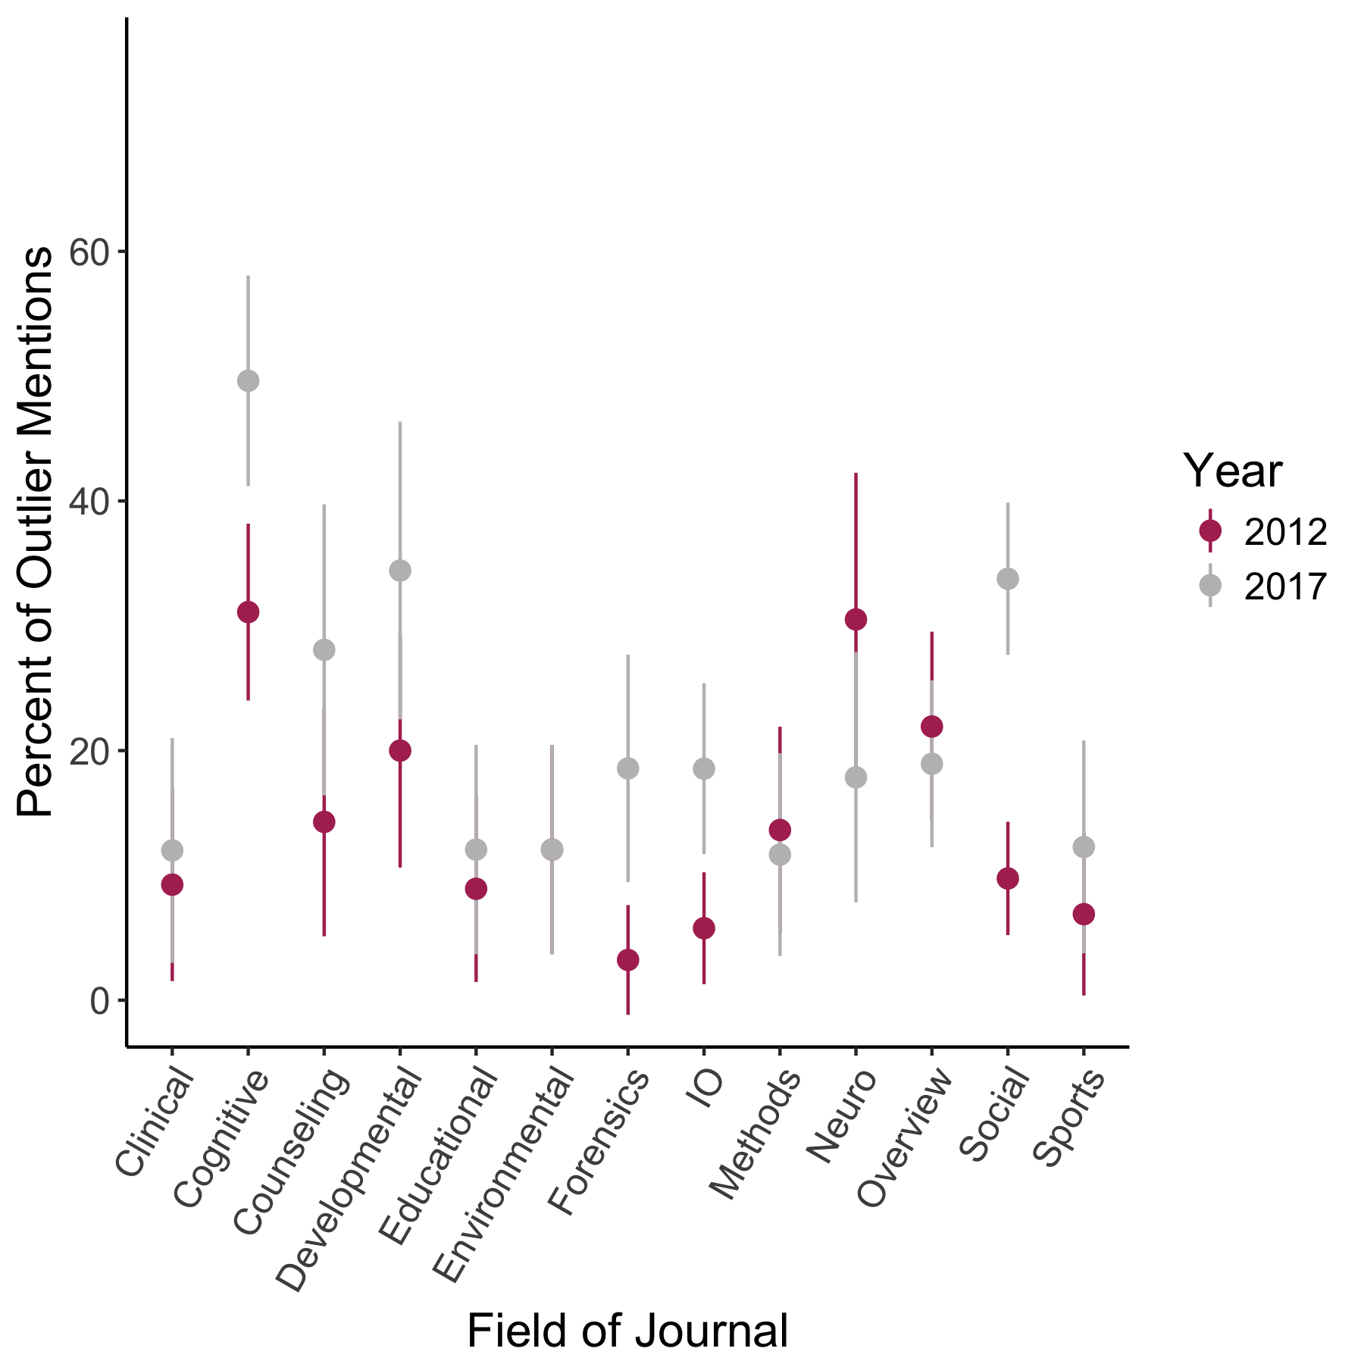
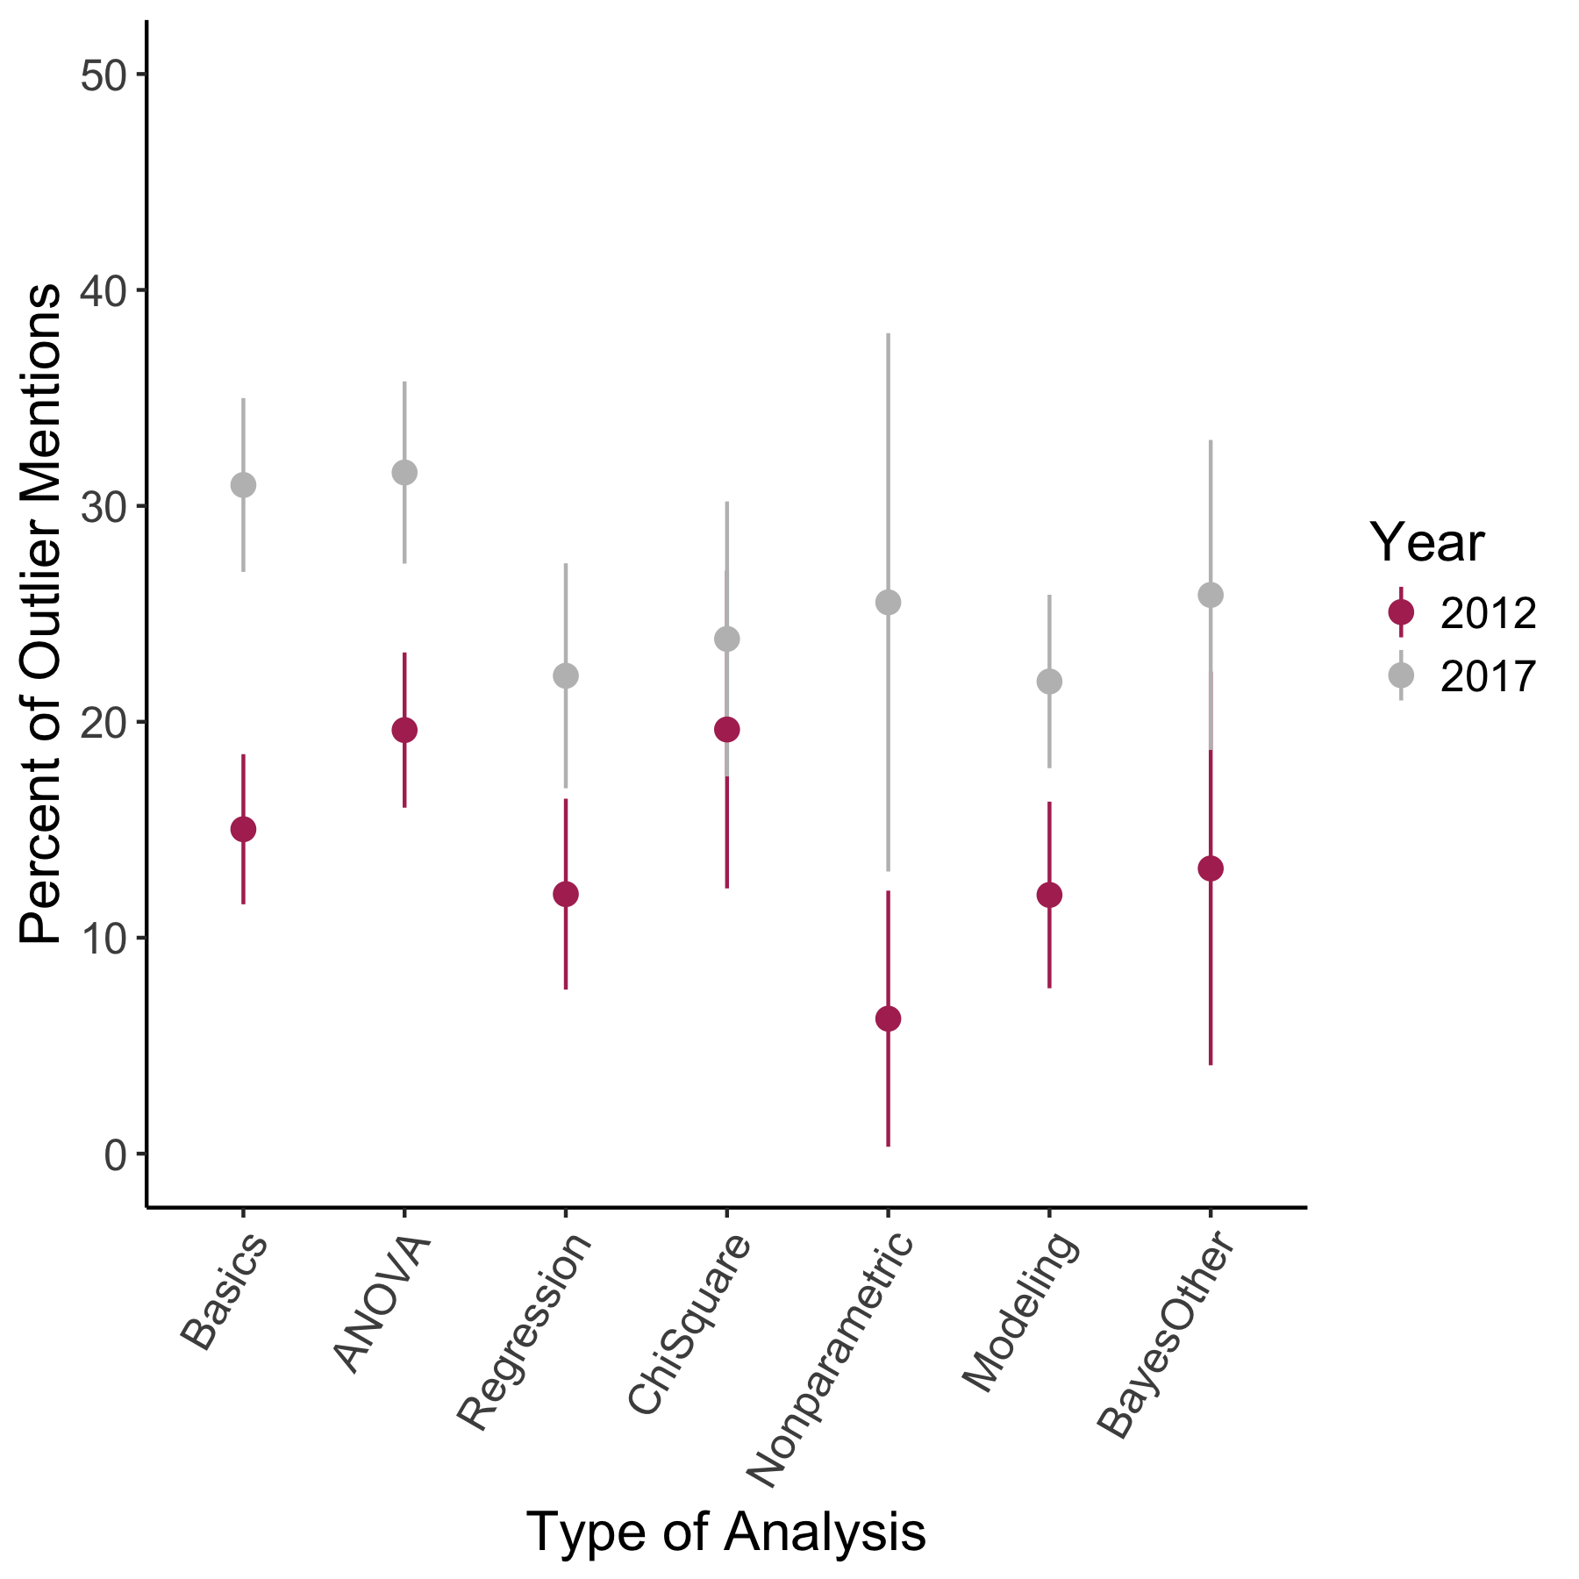
Outrageous Observations:
The Redheaded Stepchild of Data Analysis
Erin M. Buchanan, K.D. Valentine, Arielle Cunningham, Tabetha Hopke, Addie Wikowsky, & Haley Wilson
Ψ
Department of
Psychology
ABSTRACT
This study examined the impact of the growth of the Open Science Framework on report rates and transparent descriptions of outlier analyses in studies, as the importance of understanding the data manipulation in a study is crucial to creating reproducible science.
RESULTS
Year | Field | Participant Error | Statistical Reason | Unusable Data
2012 | Clinical | 20% | 80% | 0.00%
2017 |  | 33.33% | 83.33% | 0.00%
2012 | Cognitive | 50.98% | 64.71% | 3.92%
2017 |  | 67.16% | 46.27% | 0.00%
2012 | Counseling | 0.00% | 100% | 0.00%
2017 |  | 12.50% | 87.50% | 0.00%
2012 | Developmental | 71.43% | 35.71% | 0.00%
2017 |  | 61.90% | 42.86% | 0.00%
2012 | Educational | 0.00% | 100% | 0.00%
2017 |  | 0.00% | 100% | 0.00%
2012 | Environmental | 42.86% | 28.57% | 28.57%
2017 |  | 28.57% | 71.43% | 0.00%
2012 | Forensics | 0.00% | 100% | 0.00%
2017 |  | 53.85% | 30.77% | 23.08%
2012 | IO | 0.00% | 100% | 0.00%
2017 |  | 82.61% | 8.70% | 13.04%
2012 | Methods | 33.33% | 88.89% | 0.00%
2017 |  | 42.86% | 100% | 0.00%
2012 | Neuro | 38.89% | 88.89% | 0.00%
2017 |  | 0.00% | 100% | 0.00%
2012 | Social | 37.50% | 50.00% | 18.75%
2017 |  | 76.92% | 37.18% | 6.41%
2012 | Sports | 0.00% | 100% | 0.00%
2017 |  | 42.86% | 42.86% | 14.29%
2012 | Overview | 36.00% | 64.00% | 0.00%
2017 |  | 36.00% | 88.00% | 4.00%
METHODS
Fields
The topic list was created to capture large fields of psychology with small overlaps (i.e. cognition and neuropsychology) while avoiding specific subfields of topics (i.e. cognition, perception, and memory).
Journals
Two journals from each field were selected based on the following criteria: (1) high impact factors, (2) impact factors over one a minimum, (3) a mix of publishers if possible and, (4) availability due to university resources.
Articles
Fifty articles from each journal were examined for data analysis, twenty-five from 2012 and twenty-five from 2017. Data collection of articles started at the last volume publication from 2012 and 2017 and progressed backwards until twenty-five articles had been found. We excluded online first publications and started in 2012 and 2017 to ensure time for errata and retraction of articles. Articles were included if they met the following criteria: (1) included data analyses and (2) included multiple participants or data-points.
Data Analysis
All 25 articles from the different topic areas were coded by:
Types of analysis
How many participants were in the original study
If they mentioned outliers
Type of outliers mentions:
Statistical reason, participant error, or unusable data
If outliers were mentioned, were they:
People or data points
Included or excluded in the analysis
How many participants were included in the final analysis
Field | Effect Size Change (d) | Number of Experiments 2012 | Number of Experiments 2017
Clinical | 0.26 | 54 | 50
Cognitive | 2.93 | 164 | 135
Counseling | 1.66 | 56 | 57
Developmental | 1.48 | 70 | 71
Educational | 0.48 | 56 | 58
Environmental | 0.00 | 58 | 58
Forensics | 2.56 | 62 | 70
Industrial Organizational | 2.79 | 104 | 124
Neurological/ Physiological | 1.60 | 59 | 56
Social | 6.64 | 164 | 231
Sports | 0.75 | 58 | 57
Overview | 0.11 | 114 | 132
DISCUSSION
Overall, reporting of outliers increased in most fields of psychology between 2012 and 2017. Reporting also increased on average for all types of analysis.
The most significant improvements were in the cognitive and social fields. This may have been motivated by the replication crisis experienced most strongly within these branches.
(Need results for reasons.)
CONTACT INFORMATION
Dr. Erin M. Buchanan, erinbuchanan@missouristate.edu

Slide 3
Field | Data Points | Participants | Both | None
Clinical | 80.00% | 20.00% | 0.00 | 0.00%
Clinical | 33.33% | 50.00% | 0.00% | 16.67%
Cognitive | 45.10% | 50.98% | 3.92% | 0.00%
Cognitive | 28.36% | 53.73% | 17.91% | 0.00%
Counseling | 25.00% | 50.00% | 0.00% | 25.00%
Counseling | 6.25% | 81.25% | 0.00% | 12.50%
Developmental | 14.29% | 78.57% | 7.14% | 0.00%
Developmental | 23.81% | 71.43% | 0.00% | 4.76%
Educational | 20.00% | 20.00% | 0.00% | 60.00%
Educational | 57.14% | 28.57% | 0.00% | 14.29%
Environmental | 0.00% | 100.00% | 0.00% | 0.00%
Environmental | 14.29% | 85.71% | 0.00% | 0.00%
Forensics | 50.00% | 50.00% | 0.00% | 0.00%
Forensics | 7.69% | 92.31% | 0.00% | 0.00%
IO | 0.00% | 83.33% | 16.67% | 0.00%
IO | 8.70% | 91.30% | 0.00% | 0.00%
Methods | 11.11% | 88.89% | 0.00% | 0.00%
Methods | 42.86% | 57.14% | 0.00% | 0.00%
Neuro | 66.67% | 16.67% | 11.11% | 5.56%
Neuro | 70.00% | 20.00% | 0.00% | 10.00%
Overview | 40.00% | 52.00% | 8.00% | 0.00%
Overview | 32.00% | 56.00% | 12.00% | 0.00%
Social | 0.00% | 100.00% | 0.00% | 0.00%
Social | 5.13% | 89.74% | 5.13% | 0.00%
Sports | 0.00% | 100.00% | 0.00% | 0.00%
Sports | 14.29% | 71.43% | 0.00% | 14.29%

